Slide 1
Transfer outside of the substation

Slide 2
In IEC 61850, SV,GOOSE services data is inside substation ,these communication protocols are over Ethernet inside a substation.

Slide 3
There are two options introduced :
1) Internet Protocols (IP) networks (UDP/TCP)
In this mechanism, SV and GOOSE services are communicated via IP networks.
Used when if the delays of the communication network are acceptable for particular WAMPAC applications.

Slide 4
2)Tunneling
SV, GOOSE is tunneled across some high speed communication networks (Fiber Optics).
Very High Speed.

Slide 5
Protocols uses across the internet
TCP/IP Stands For : Transmission Control Protocol. requires a handshake in which the receiver agrees to the communication before the data is sent. Data sends in chuncks. | UDP/IP User Datagram Protocol. Not requires a handshake.

Slide 6
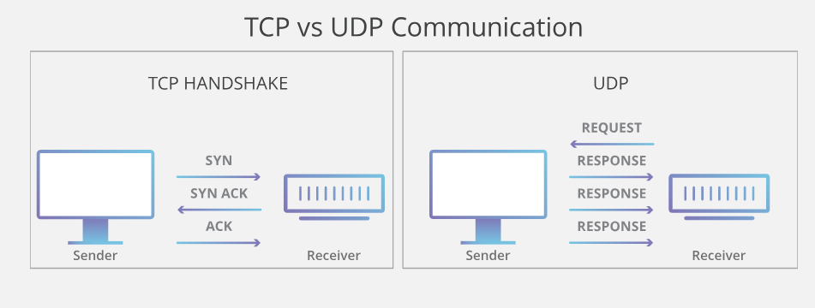

Slide 7
But in our project we simulate the internet protocol by using radio frequency to transmit the data from the PMU to PDC.
And we simulate the fiber optics by 8 wires (8bit) to transmit the data from PMU to PDC and that’s faster in time than the first method.

Slide 8
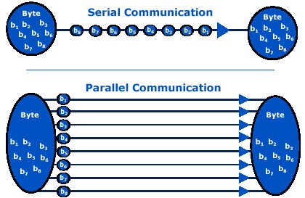
Comparison between sending data in serial communication and parallel communication:

Slide 9
Serial communication:
The advantage of serial communication (internet protocol) method is that it doesn’t need a lot of wires to transmit the data.
The disadvantage is that the data needs long time to be transmitted.

Slide 10
Parallel communication:
The advantage of parallel communication(Fiber Optics) is that the data is transmitted at the same time(very fast).
The disadvantage of parallel communication is that it needs a lot of wires.

